Slide 1

NetBoards
Investigating a Collection of Personal Noticeboard Displays in the Workplace
Erroll Wood
erroll.wood@cl.cam.ac.uk
Peter Robinson
peter.robinson@cl.cam.ac.uk
Notes:
Hi I’m Erroll Wood,
A PhD student at the Graphics and Interaction group at the Cambridge Computer lab,
And today I’m going to be giving a short talk about our new situated display project, the NetBoards.

Slide 2
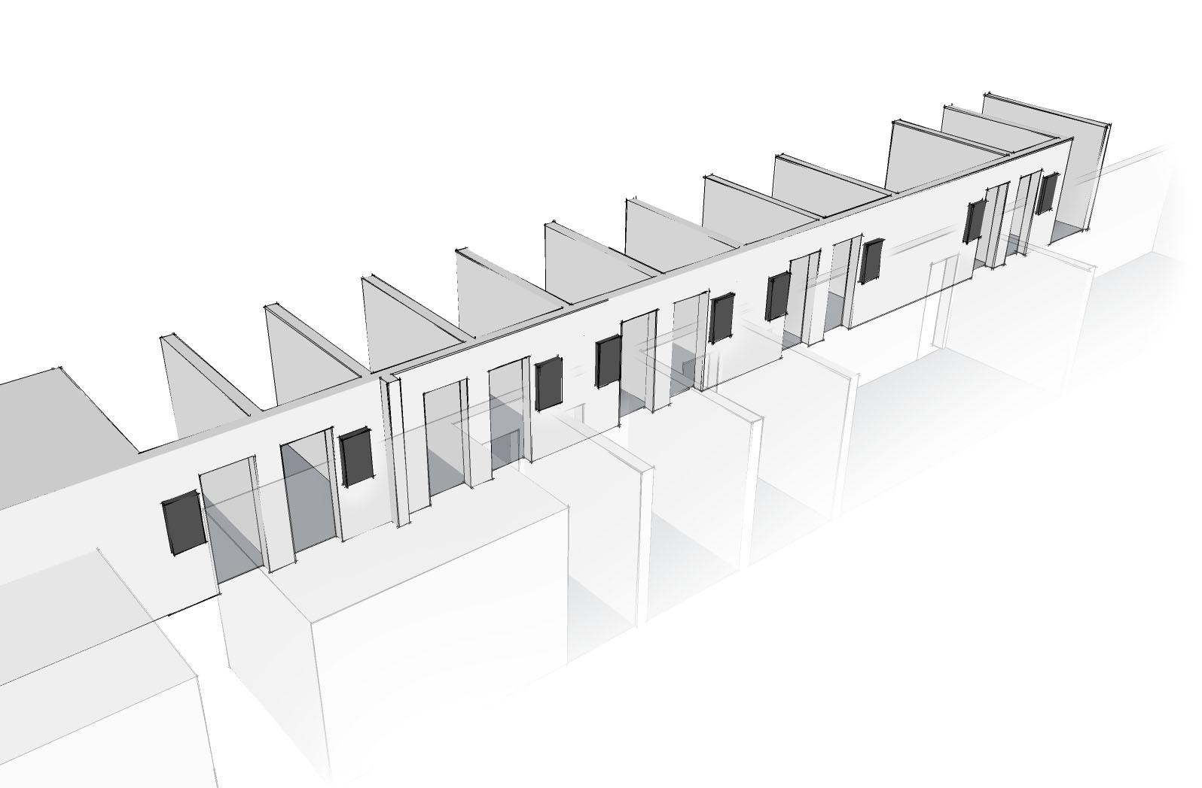
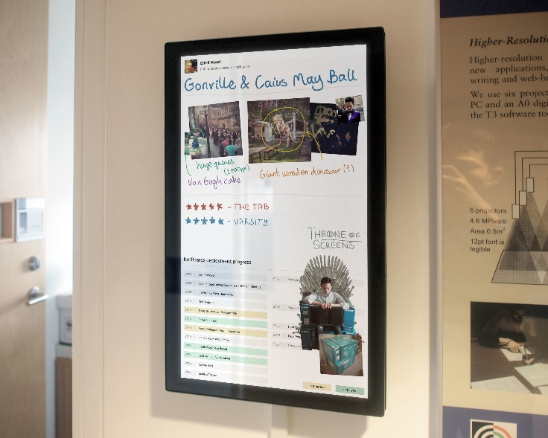
What are NetBoards?
Situated personal noticeboard displays
Notes:
So what are NetBoards?
We’ve seen a lot of exciting and innovative interaction research over the last two days, but this project’s core concept comes from all the way back in the 1990s.
NetBoards are an application of typical Weiser-style UbiComp we are all familiar with
We have deployed a collection of 10 digital noticeboard displays throughout our research group’s corridor, and are now collecting data on their use.
They are called NetBoards as they function entirely with internet technologies (everything is a webpage), and they are all accessible over the internet.
They’ve been running for about 4 months now in their current form, but the plan is to keep them running indefinitely.
While there’s nothing particularly novel about the software or hardware, we think that a long term study of a collection of interactive noticeboards might lead to valuable insights into the future of ubiquitous computing in the workplace.
In this talk I’ll describe the projects conception, design process, and system architecture, and finally discuss some of the informal observations we have made so far on their use.

Slide 3

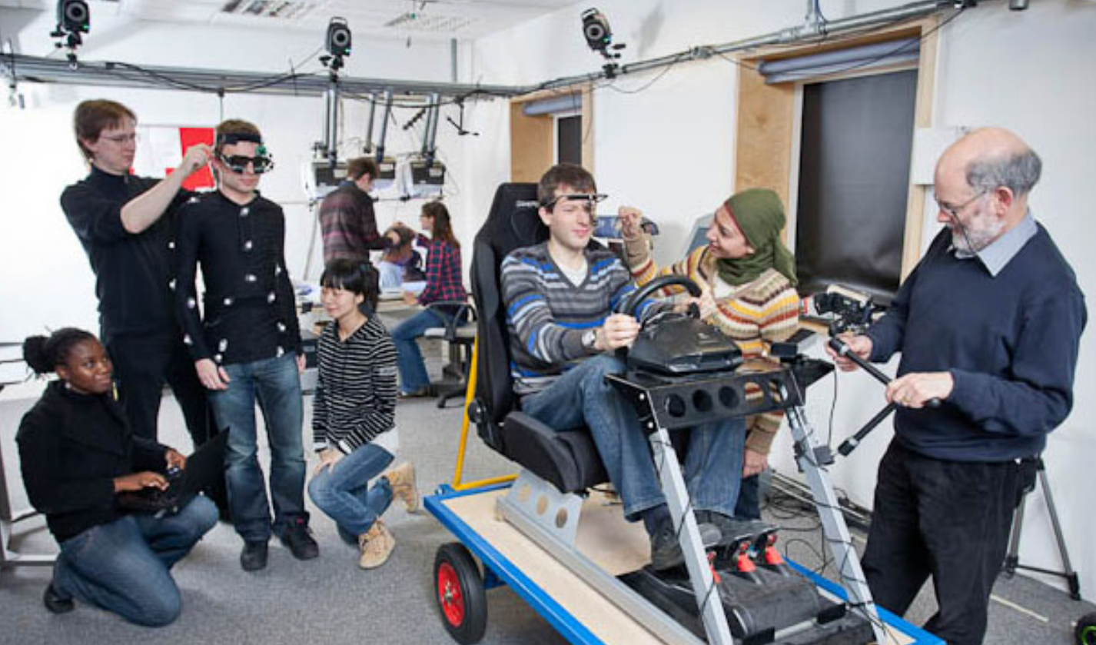
Environmental context
Deployed over the Graphics & Interaction Group
www.cl.cam.ac.uk/research/rainbow/
22 members, 13 offices, mostly PhD students
Notes:
However, we know context is a key factor for public displays, so I’ll first describe the deployment environment – the Rainbow Graphics and Interaction group.
We have 22 members in our research group, and it consists mostly of PhD students.
We are very fortunate in that most of us occupy small offices with only one or two people.
This makes ours a different workplace environment from other known research, involving large peripheral displays being studied in large shared offices of 10 people or more.
Each office now has a NetBoard outside it which functions as a personal noticeboard.
So that’s a lot of hardware! It’s be a shame if it all went unused, so how did we design the NetBoards to try and prevent this?

Slide 4
Pre-deployment study
Ubiquitous systems must be carefully designed to minimize the disruption of existing every-day practices
We conducted a study to examine how non-digital noticeboards are used
Notes:
For a situated system to become accepted by users in their daily routines, it must be carefully designed to minimize the disruption of existing every-day practices.
Otherwise, if it doesn’t fit in with behavioural expectations and associations, it will be rejected.
We therefore conducted a pre-deployment study to provide an understanding of how the existing non-digital noticeboards are used.

Slide 5
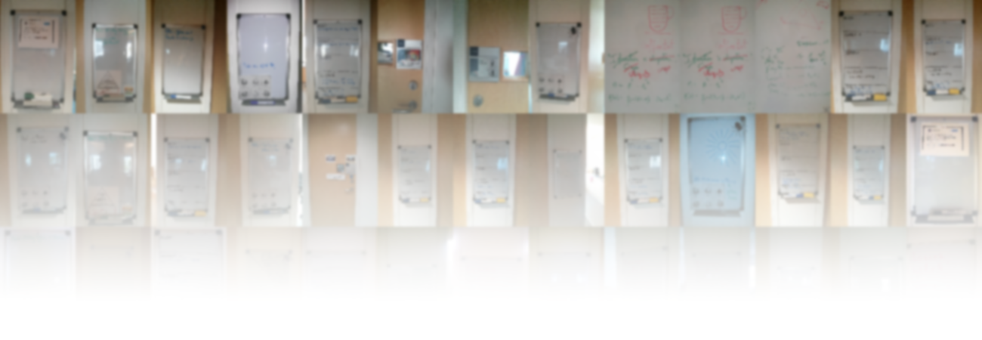
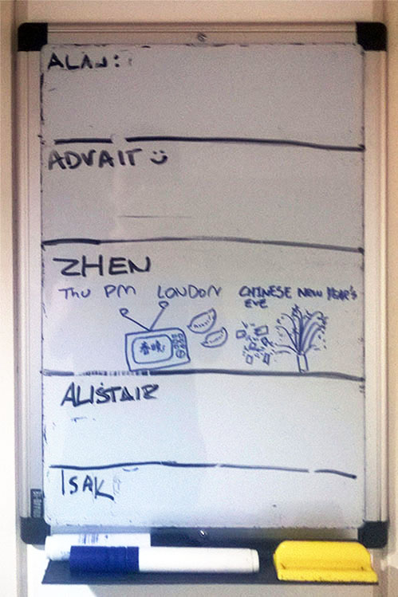
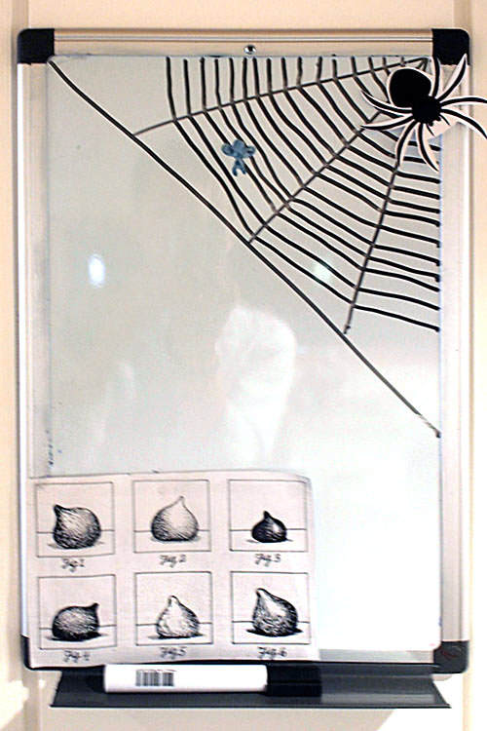
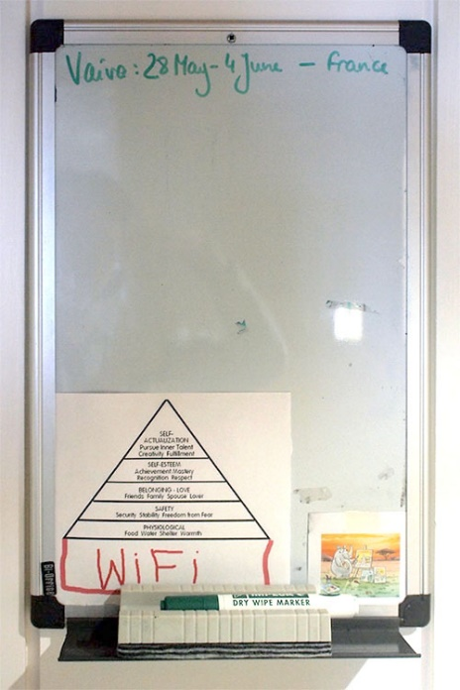
Pre-deployment study
Collected 50 images over six months
Notes:
We collected noticeboard data over six months, taking photos every time a personal noticeboard was changed.
This resulted in a corpus of 50 images exhibiting both the methods used to create content and the different types of content.
This might seem like a small number, but the fact is that these noticeboards just aren’t modified that often! Even though people see them every day.

Slide 6
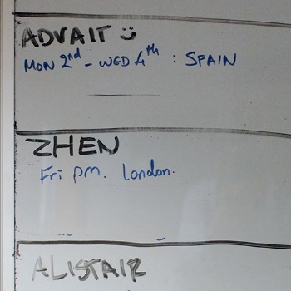
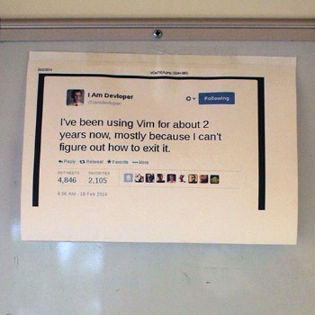
Pre-deployment study: content creation
Content is created using two methods
Inking
Printing & sticking
Notes:
We found that personal whiteboard content on our corridor was created in only two ways.
The first – inking, is the most obvious. This is where people pick up a marker pen and either write or draw on the whiteboards.
The second is printing and sticking. This is where people print out text and images, and affix them to a noticeboard with sticky-tape.

Slide 7
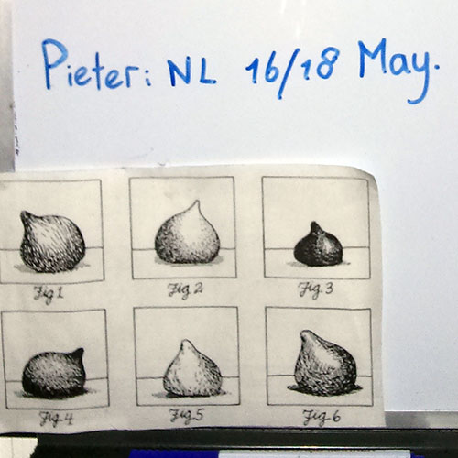
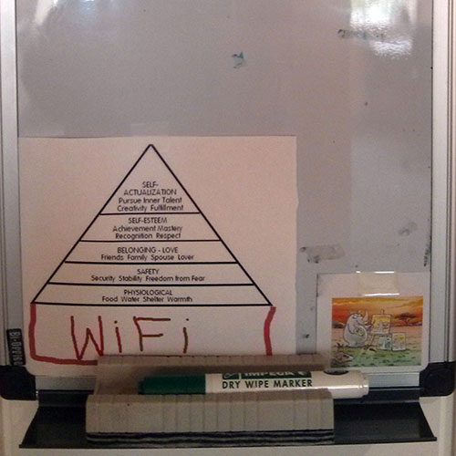
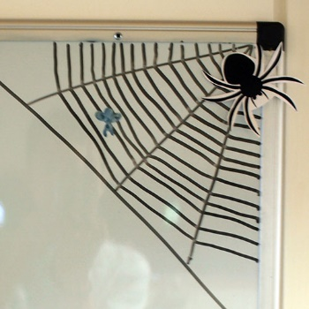
Pre-deployment study: types of content
Content fits into three categories
Notice of absence
Humor
Play
Notes:
But what types of content was created?
Interestingly, despite the wide range of possible message-types that could be posted, we discovered most messages fit into three categories.
By far the most common type of content concerned office absences. In a large research group, someone is always away on vacation or at a conference, and even when not abroad they are often teaching or attending duties in town.
It might seem archaic to rely on non-digital noticeboards for relaying this kind of information, but displaying this data outside an office has natural benefits.
While emailing the whole research group might be intrusive, this way only people who actually come looking for you will find out your whereabouts.
We also saw a lot of “funny images” posted. Humor is pervasive in the workplace, and helps with relieving stress, team unification, motivation, and idea generation. Therefore it’s unsurprising that people use noticeboards for these purposes.
People also elaborate on humorous images. Here you can see Laslow’s pyramid of needs, but with WiFi added to the bottom.
The finial class of content is more interesting. Sometimes people would decorate their noticeboard with sketches and images, not designed to make people laugh, but rather instead provide some playful amusement and distraction in what can be a serious environment.
Perhaps its surprising that work-related items are non-existent, perhaps it’s a reflection on the nature of our research group…

Slide 8
Motivation
The existing non-digital system is good, but there are some issues
Sometimes we want to edit our noticeboard, but we are out-of-office
We are forgetful, and we leave the same content up for ages
Notes:
Before disrupting the workplace … we had to ask ourselves why? Aren’t existing noticeboards good enough? Why do you want to replace them?
Some issues do become apparent…
Don’t want to email someone and make them do it – unwelcome distraction
We are forgetful, and also lazy people. It is generally the office occupant’s responsibility to maintain their noticeboard, but often they neglect them. Printing, cutting, and sticking takes effort, and we found that printed and stuck items remained on noticeboards indefinitely.

Slide 9
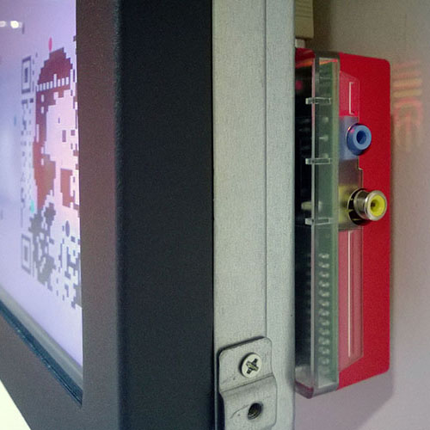
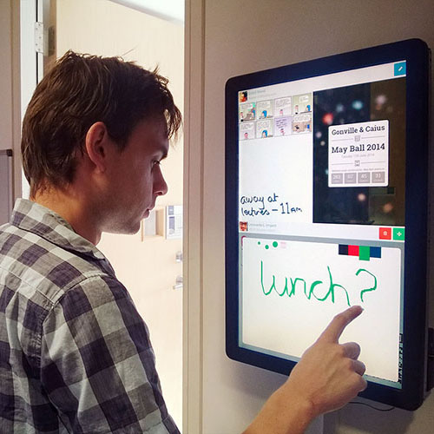
Prototype deployment
Driven by a Raspberry-Pi
Ancient touch-screen technology interface
Notes:
When experimenting with large collections of expensive hardware, iterative cycles of design, deployment, and observation are critical in ensuring the system fulfils its goals and is well received.
We deployed five units that were powered by Raspberry Pi – these seemed ideal as they’re low power and low cost, excellent for large-scale deployment.
We also happened to have a collection of touchscreens lying around the lab…
They were actually acquired by a research group member in a shady deal involving a casino company that went bust…
These ran web-apps similar to the current iteration, so I’ll describe those in more detail later.

Slide 10
Prototype observations
They generated excitement
They weren’t good enough
Dependable: users expect them to work
Easy to use: users won’t bother if they have to learn much
Notes:
They certainly generate interest along the research group, and even jealousy from others.
It was clear that we had a good idea here. People liked using them
But they also had several issues
Raspberry Pis are great. But they’re not dependable.
If you want them to show a slide-show perhaps, that’s okay, but you can’t expect long uptime.
And worse of all is that they have a habit of trashing their own SD-card…
For a system that’s supposed to be used every day, this is unacceptable. People became used to …
The combination of low-power device and dodgy touchscreen tech led to some interface decisions that were confusing for users. If they couldn’t figure out how to do something, they’d just not use it.
This made us realise, we needed to redeploy the system with improved hardware and software

Slide 11
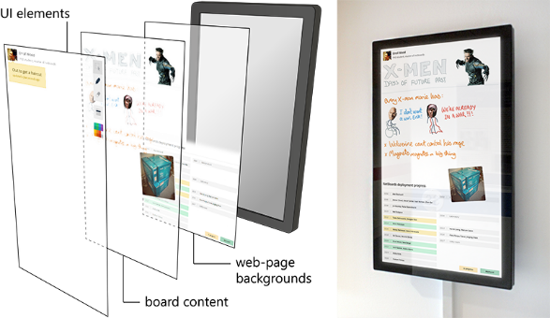
The NetBoards system
Notes:
So we come to the current NetBoards system
Each NetBoard is a 22-inch portrait oriented wall-mounted touchscreen
10 capacitive multitouch
Each one is powered by PCs that we keep under the floor. (one PC, two screens).
Each NetBoard runs a full screen web browser which serves as an editor. This is how people edit the boards in-person.
The content displayed on the boards consists of three different layers.
The first contains user interface widgets and details of the office occupants
The second contains the actual board content – inked items and images
And the final layer is an optional web-page background layer. As we’re a computer science dept., everyone can write their own software. We decided that rather than try to squeeze as many features into the NetBoards as possible, we can let people write their own software (as webpages) and display it if they choose.

Slide 12
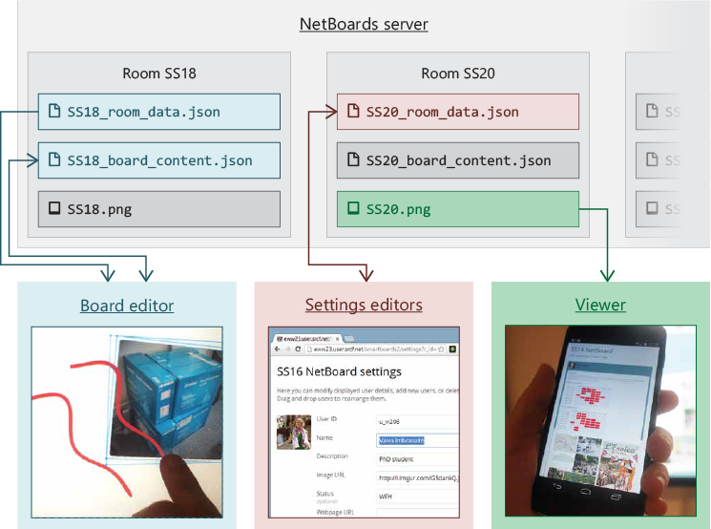
Web-based architecture
Notes:
Some brief notes on the boring part: how do these actually work?
Remote access was a key feature, so web-based technologies made sense.
The content (pen paths, images, etc.) and settings are stored on our server as .json files – these are loaded by browsers or NetBoard units themselves for displaying boards.
Separate web-apps allow users to modify their room settings online.
However, we found mobile devices were just a bit too weedy, so we also render the NetBoards server-side into .png files. These can be viewed more easily on mobile, handy if you want to check if someone’s written on your NetBoard.

Slide 13
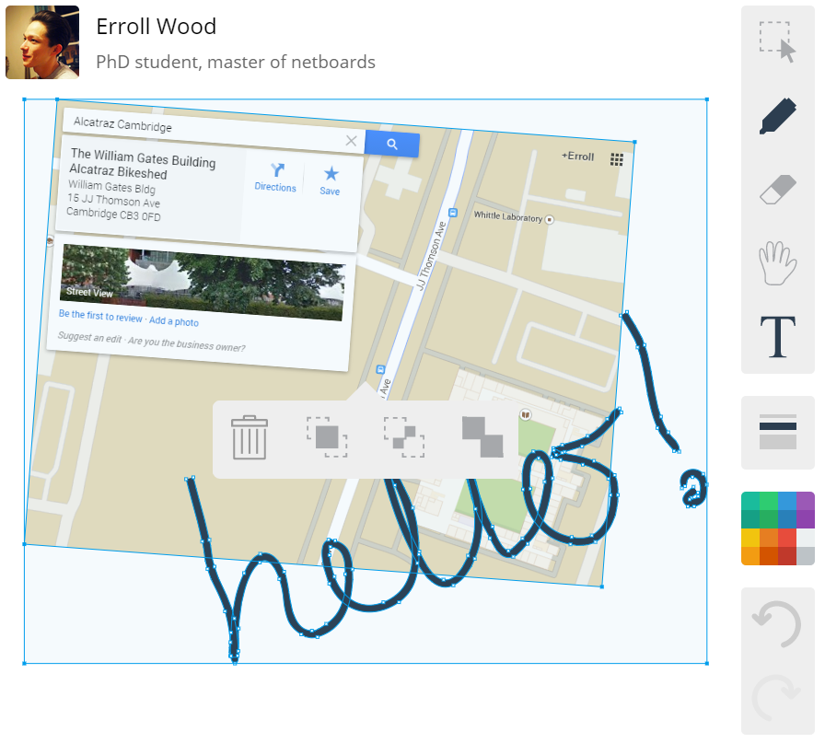
Modifying content
Each NetBoard can be accessed and edited online
We adopted standard multi-touch interaction techniques
Mouse controls are available for desktop use
Notes:
Editing the NetBoards is done using web-apps on the internet.
These are touch-enabled, and we replicated standard multi-touch interaction techniques for drawing paths and manipulating items.
We used One Note as inspiration
We also of course have mouse tools that allow the precise modification from desktop or laptop devices.
These work quite well with a pen also
It was important to keep things familiar for users – we don’t want there to be much of a learning curve, so we didn’t try any fancy novel techniques.

Slide 14
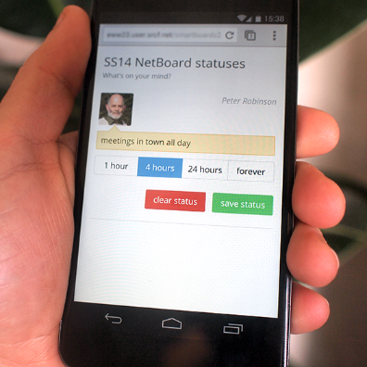
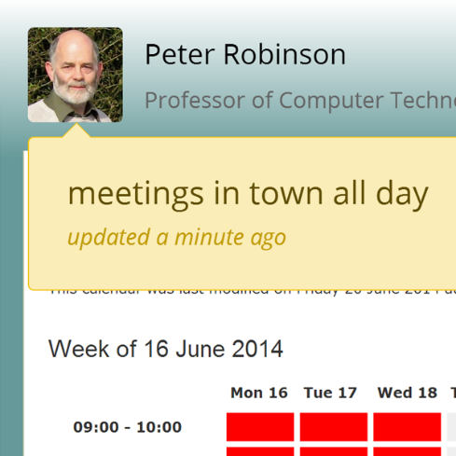
Modifying content
Users can enter text status online
These appear in the UI layer
Notes:
We found mobile devices were a bit too small and often too weak to load the fully-fledged web-apps.
Instead we developed short text-statuses that can be set with a web-app.
These can also be timed, e.g. to disappear after an hour, or a day etc.
This helps avoid “stale” content – messages that were posted that become erroneous once left for too long

Slide 15
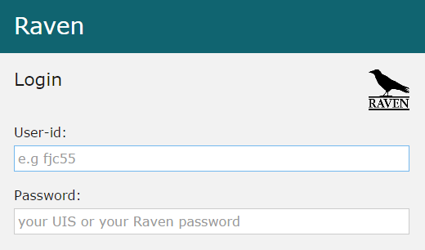
Security issues
Shouldn’t we be worried about vandals?
Our security model matches the original noticeboards
If you can have physical access to a board, you can edit it.
Semi-public setting is not accessible to undergraduates or the public
Online access handled by Raven
Notes:
Lots of people chatted about security issues…
If we were in a public place, or in a school, then probably!
We made a conscious decision to match the security model to that of the non-digital noticeboards.
If you can have physical access to a NetBoard, you are allowed to modify it
Our corridor is secured via card access, so people can’t access it in general.
Remote access is important, so this is handled by Cambridge’s Auth. API.
It was important that we didn’t have our own auth. System, we wanted it to be easy for new users

Slide 16
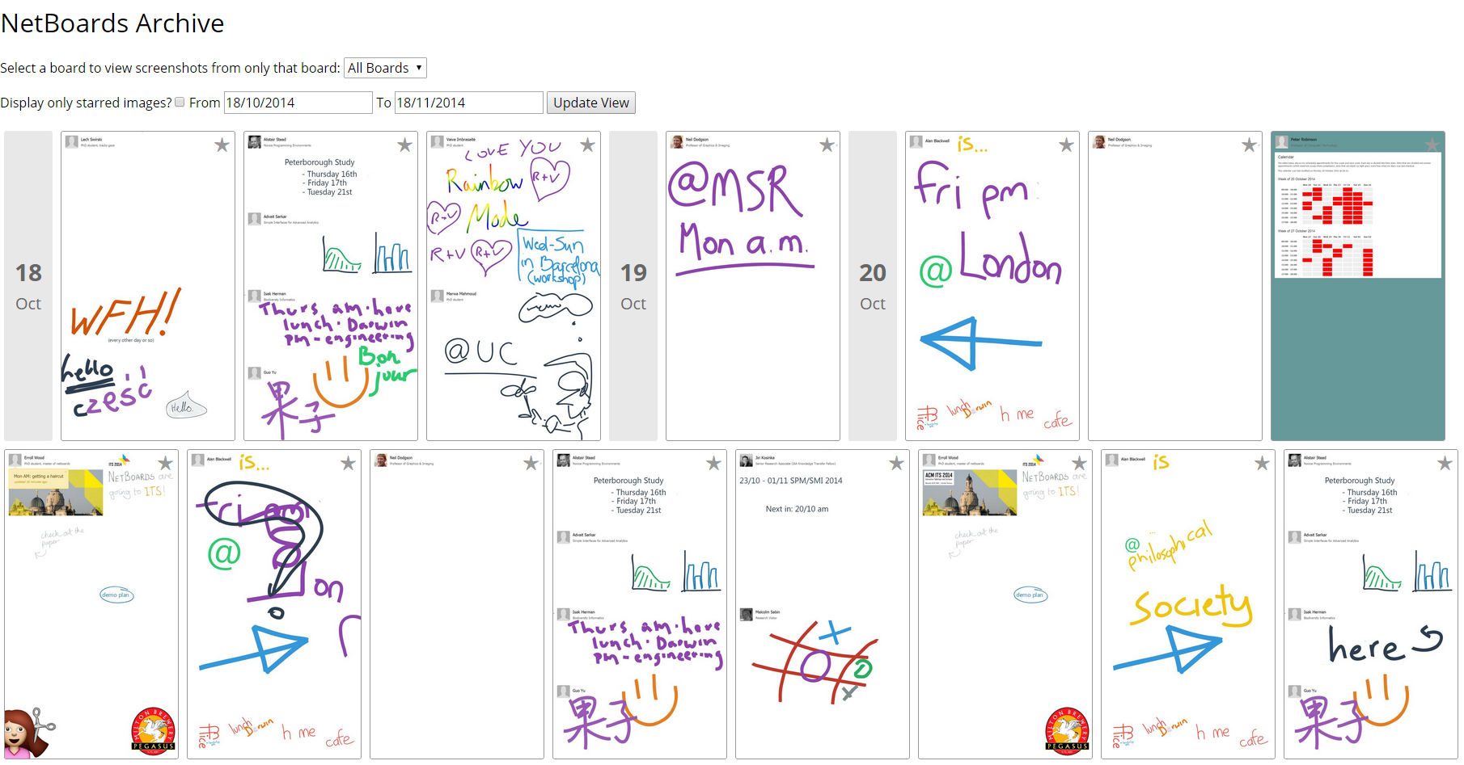
Early user experiences
Notes:
We haven’t yet done an in depth analysis on how these things are used, but we’re already seeing some interesting phenomenon.
It’s probably easiest to illustrate if I give a few examples, and tell the stories behind them.
What you can see here is a screenshot of our image archive where we collect image data from the server
I’m aware that anecdotes are not data, that study is to follow, but we are already seeing differences in the ways people use digital …
I’ll first show some of the predicted use cases, similar to the content we discovered in our study,
and then I’ll move onto some more interesting stories showing the more surprising ways in which they have been used.

Slide 17
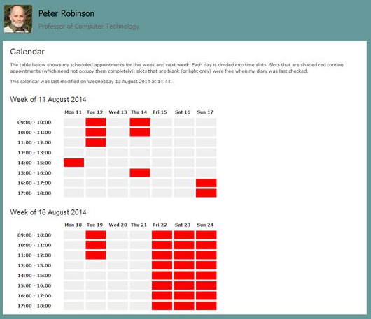
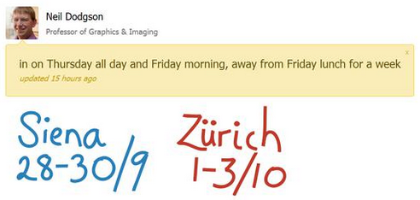
Notices of absence
Notes:
As before, the most common type of message posted is a simple notice of absence.
These range from inked messages to textual status messages, or sometimes a combination of both.
When working from home or from town, people now update their board remotely, so that if someone’s not in their office, it’s easier to have an idea when they’ll be back.
Interestingly, one professor has developed their own personal background web-page that parses their online calendar, and shows the future times they’ll be available.
This of course is important for students eager to seek their advice…
So in this way the NetBoards enhance group awareness – we are now better aware of our colleagues whereabouts and can shift between loose and closer collaboration more easily.

Slide 18
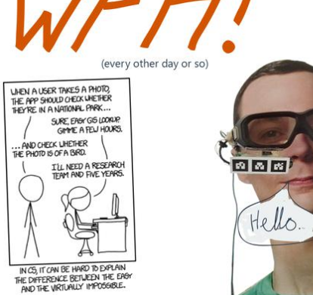
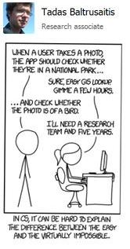
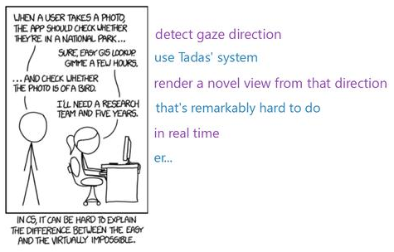
Funny comics are popular
Notes:
Of course, funny images and comics are very popular decorations, just as before.
But now it’s so much easier to add images, with just dragging and dropping from web browser or file system, so the rate of turn-over is increased.
Perhaps this means an increase in the overall Humor level, I’m not sure how to measure that yet
Here is one interesting example where a computer-vision oriented XKCD comic came out, and three separate users posted it to their board on the same day
Without noticing yet that others had done the same
Some users ended up elaborating on the comic in different ways –this shows different people’s perspectives on the same comic

Slide 19
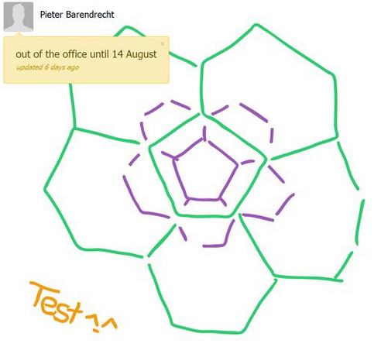

People playfully decorate their NetBoard
Notes:
And again, we experienced playful behaviour
Not necessarily “humorous” decorations, but some users chose to curate and make their NetBoards “pretty” perhaps. These are pleasant distractions in what can be a serious environment.
These ranged from stylised visualizations of mesh structures (this is a graphics student) to animated javascript background web-pages. This example here changes colours over time in a pleasing way.

Slide 20
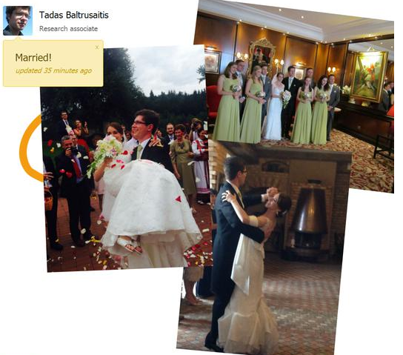
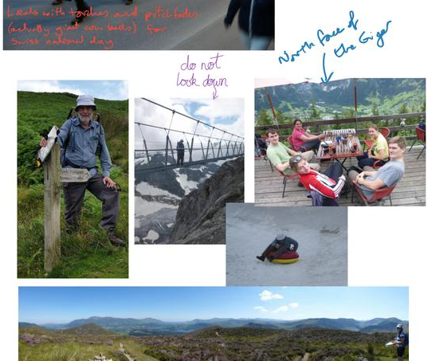
Holiday photos
Notes:
So onto the new stuff – these are use cases that didn’t occur with the non-digital equivalents.
Whenever peripheral displays are deployed in the workplace, studies show that they are always used for holiday photos.
People love to show off what they’ve been up to and the fantastic places they’ve been.
This guy got married recently, so of course was eager to show off to the lab
Using remote editing, people also upload photos while they’re abroad. This way people in the office receive passive updates from them, rather than just their empty room.
It gives them a sort of remote presence. Even though they’re not in the office, you are aware of what they’re up to.
They also annotate holiday images with ink or text. When they return people are ready to chat and ask them questions about where they’ve been and how they enjoyed it.

Slide 21
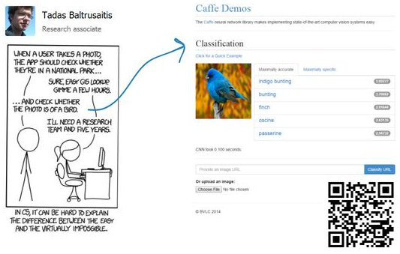
People have conversations
Notes:
Users also have “conversations” using the NetBoards
They do this both in person at the NetBoard, and remotely.
It’s a new, informal communication channel where you are also broadcasting your comments to your work group.
In this example from the XKCD comic, another user has posted an image to someone else's NetBoard, showing an image classification system solving the problem in the comic.

Slide 22
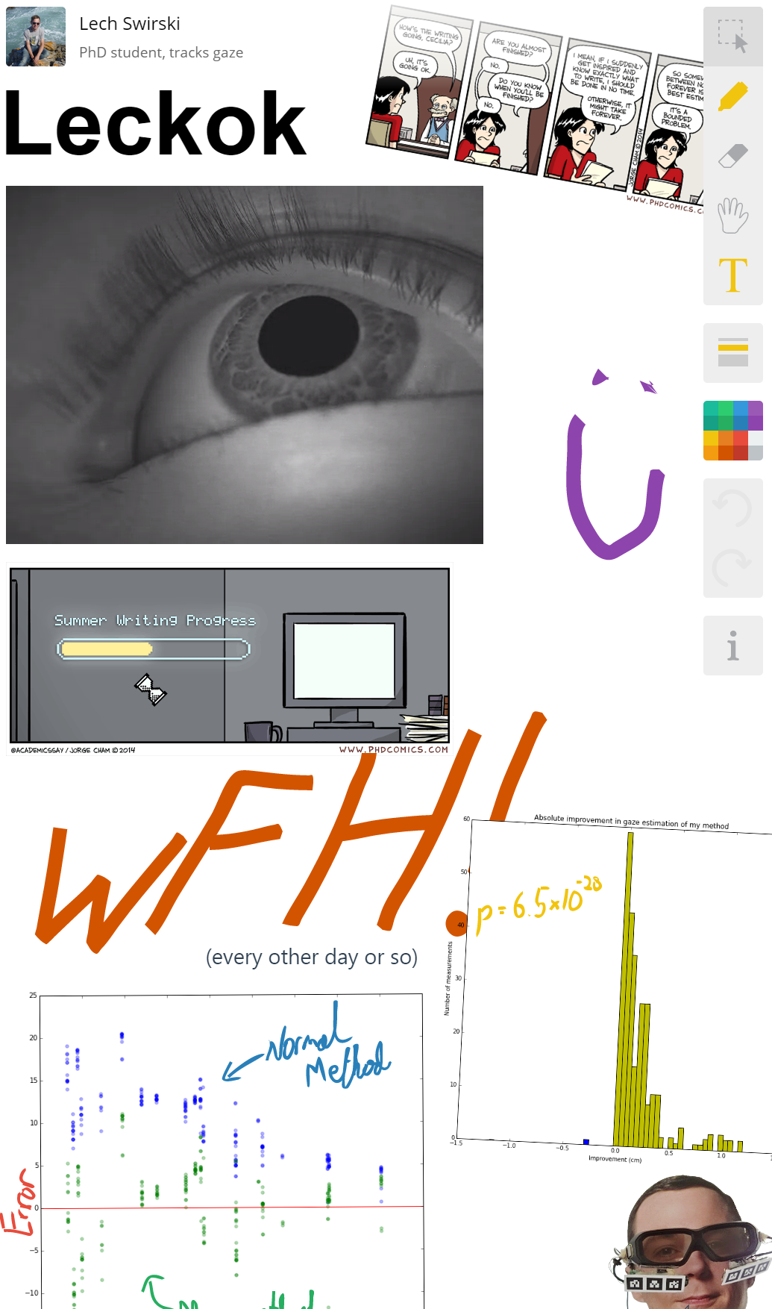
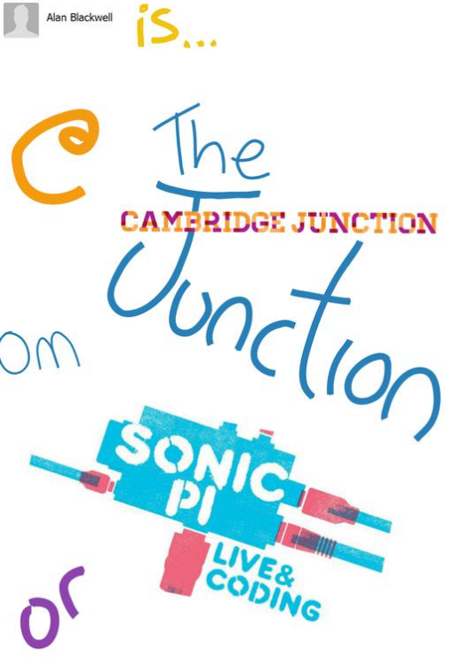
Showcasing work
Notes:
Another new way the NetBoards are used is to showcase work.
Our research group frequently has visitors, and students might want to coax them into a conversation. However, it might be rude or intrusive to jump out at them and start preaching about your research.
Instead people put videos, graphs and images up of their work.
This student has a video of eye-tracking data
This professor is proud of teaching events he has organized
This way, passers by stop and look at NetBoards, and if they’re interested pop their head into the office and start a conversation.
This is actually a very interesting phenomenon where users are acutely aware of when people stop outside their offices and examine their NetBoard.
You can hear when some one has stopped outside and laughs at a funny image
They feel encouraged to curate them,

Slide 23
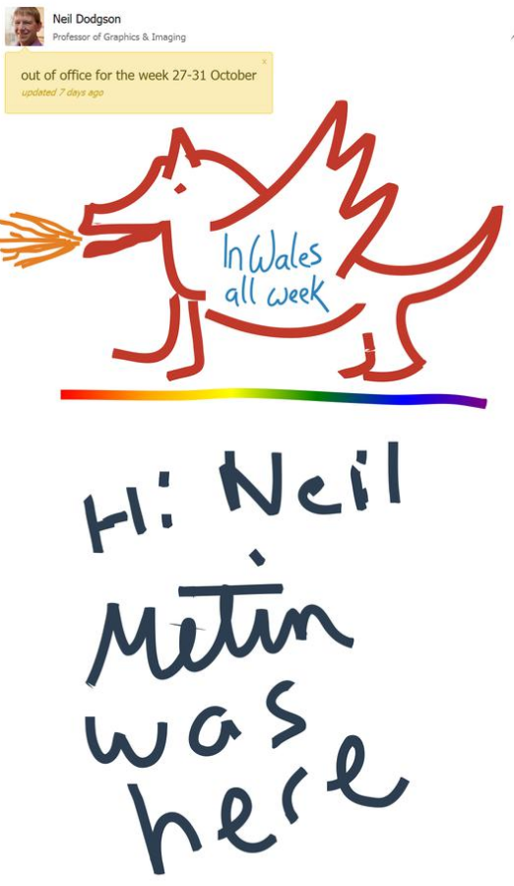
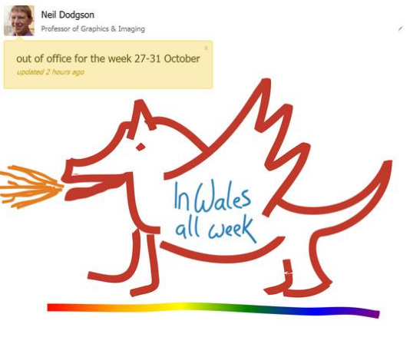
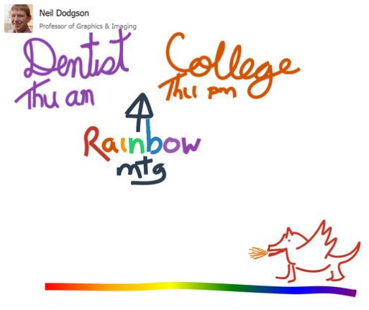
People become attached to their masterpieces
Notes:
People became attached to items on the non-digital noticeboards – once they’d made a masterpiece, they were unwilling to erase them.
This is a nice example of how NetBoards avoids this
First, a user has created a masterpiece drawing of a dragon. He’s going on holiday to Wales – they have a dragon on their flag
Then when he’s away, one of his former students visits the lab, and leaves a little message for him saying hello.
Once he returns, he erases this. He needs to write new stuff on his board, but he doesn’t want to delete his masterpiece. Instead he shrinks it down, and it can remind him of the fun times he had in Wales for a little longer.
It’s the little stories like this that interest us – this would be impossible with the non-digital noticeboards.

Slide 24
What’s next?
Collect more data, and analyse it
How could we use proximity, identity, or attention?
We would love to deploy more NetBoards!
Different types of users might use them in different ways
Notes:
So where are we going with the project? (Thanks everyone for the great ideas yesterday!)
As interesting as the anecdotes are, the proof is in the data analysis. We will keep collecting data for a while, until we have a year’s worth of data or so.
We can then examine both how and what people use their boards. This quantitative analysis will suggest courses of qualitative analysis, so we can extract people’s feeling through interviews.
It would be great if we could also track proximity, identity, and awareness. We could then start to measure who writes on who else's NetBoard.
If we could pervasively track gaze, we could check when people look at the NetBoards
We also hypothesise that the NetBoards actually encourage communication – if we could track person-to-person interaction over a long time, this might be able to show this
And of course, we would love to deploy the system over new areas. Previous research has shown different groups use ubiquitous displays in very different ways
We’re a graphics and interaction group, perhaps we’re disposed to playful and decorative behaviour? How might the security group use the system differently?

Slide 25

Conclusion
We deployed a collection of ten personal noticeboard displays, and are collecting data on their use
Examining the differences between digital and non-digital systems
People use them in surprising ways!
What did we learn?
Don’t let yourself be hindered by technology
Long-term deployment scenarios are challenging
It’s available online: github.com/errollw/smartboards2
Notes:
So to recap: we’ve deployed a collection of personal noticeboard displays and are collecting data on their use
We are interested in the different ways people use digital and non-digital …
We’ve found that by augmenting something as simple as a personal noticeboard, you can enable new and interesting interactions
And what are the lessons so far?
Don’t let yourself become hindered by technology, especially if you’re planning a long-term deployment. We should have iterated faster…
Long-term deployment scenarios involve a lot of additional engineering. If you want a system to be robust, you have to be pragmatic and make some sacrifices.
And also, if you can, don’t be afraid to just go ahead with a project without a specific goal in mind.
I’d be lying if we thought these would make us more productive, or if we had some big hypotheses that we wanted to test. We just wanted something, and so we made it happen, and we’re having more fun at work!

